Slide 1
Prep Priority Setting Meeting
12th March, 2018
National AIDs & STI Control Program
Silver Springs Hotel , Nairobi

Slide 2
Targets 2017/2018
Population category | Targets
Men having sex with men(MSM) | 6,556
Female Sex workers (FSW) | 44,268
People with Inject drugs(PWID) | 7,317
Discordant couples | 4,990
Adolescents and youth(15-24 years) (2015 baseline) | 9,205
General population>25 years (2015 Baseline) | 14,731
Total target | 87,067

Slide 3
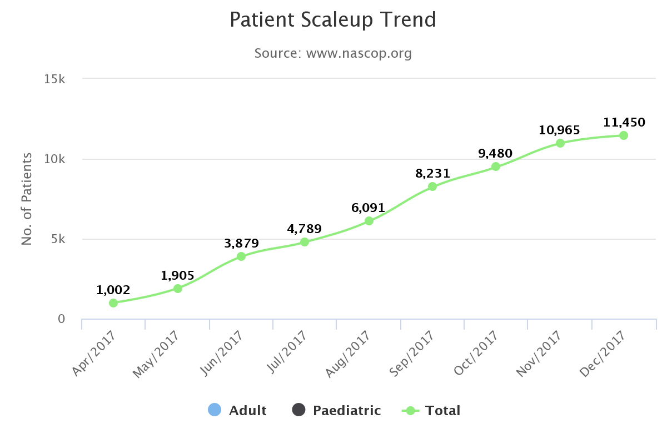

Slide 4
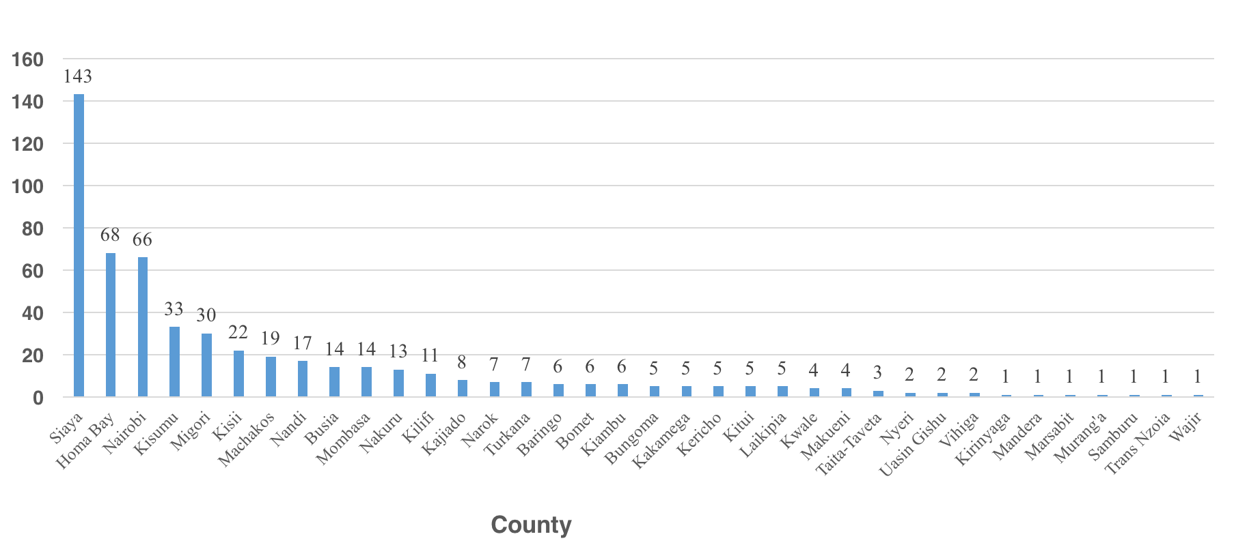
Facilities providing PrEP ( Dec 2017)
539 Facilities in 36 counties

Slide 5
Pre-exposure prophylaxis: overall priorities
Priority Areas | Priority actions
Scale up of PrEP | Target for 2017/2018 is 87,000 persons on Prep : estimated coverage about 15% Implement as a comprehensive prevention package for clients Integrated into existing services for different populations e.g. YFS for AYP Private sector engagements for scale up of PrEP within private sector Communication , advocacy
Generation of data for PrEP | Rolling out of M and E tools and invest in EMR for Prep Impact modelling, Costing of provision PrEP Surveillance – outcomes , demand and uptake by sub-populations, provider and client preferences
Adherence, retention | Investment in client follow up and support mechanisms
Coordination | Technical meetings , data generation and hosting , monitoring, supervision , QA, both at national and county level

Slide 6
Coordination and Planning
Activities/ priorities | Partner Support
Quarterly TWG meetings
Quarterly Sub committees meetings - planning and coordination, research, commodities, service delivery , m and e, communication
Annual CASCO and Partners meeting ( progress review , best practice-clustered)
Documentation of roll out of PrEP in Kenya
Review of PrEP roll out scenarios ( new estimates and scale up ) Define County clusters based on epidemic
Conduct a partners resource mapping and stakeholders analysis( implementers, key actors)
Develop online directory of services and PrEP resources
Support counties set up PrEP coordination structures ( develop county SOPs, set up TWGS and support meetings)

Slide 7
Service Delivery and Operations
Activities/ priorities | Partner Support
Develop PrEP Operational guideline/ materials for adherence retention, cohort monitoring for Clients and HCWs | Global fund part support
Develop a national training and mentorship plan, inventory of trained staff
Printing and distribution of service provider toolkit
Conduct targeted trainings of TOTs in counties
Private sector engagement including stakeholders meetings Capacity building Support assessments and accreditation
Annual DQA and service quality audits
Development of comprehensive prevention package toolkit | Global fund support

Slide 8
Monitoring and evaluation
Activities/ priorities | Partner Support
Roll out data tools (printing, training distribution), DHIS reporting support
Develop HIV prevention cascade
Support for PrEP electronic medical records
Develop and produce quarterly progress reports for dissemination to counties and stakeholders
Development of dashboards/data visualization tools
Roll out existing tools (printing, training distribution)

Slide 9
Research and Surveillance
Activities/ priorities | Partner Support
Create a PrEP evidence data repository at NASCOP- past, current and planned studies ( potential to combine with documentation)
Surveillanace of HIV Seroconverters HIV DRT plan | GEM-USAID Support
Costing and cost effectiveness of PrEP in Kenya: consolidate existing data to determine unit cost of service
Conduct research as agreed on research agenda ( across the various areas ) | (Partner to highlight any current priority research areas)

Slide 10
Communication and Advocacy
Activities/ priorities | Partner Support
Develop communication strategy and implementation plan
Develop communication material by target groups
Develop & support survey for service providers on PrEP
Printing of communication materials
Community consultations
Support conduct of continuous demand creation activities Including mass media campaigns
Identify national & community PrEP champions and train them
Training of media teams - continuously
Conduct forums/outreach at tertiary institutions -integrated with HTS as part of combined prevention package.

Slide 11
Commodity security
Activities/ priorities | Partner Support
Procurement of commodities for Prep ( ARVS)
National quantification for PrEP and related laboratory products
Dissemination of revised LMIS tools ( print and distribution and training)
Support reporting of commodity data into DHIS 2 and electronic dispensing tools across facilities ( TA to facilities and supervision)
Capacity building on pharmacovigilance and rational use of PrEP commodities

